Slide 1
SQL Final Project Submission
Name : Amardeep Jha
Batch : March 15,2024

Slide 2
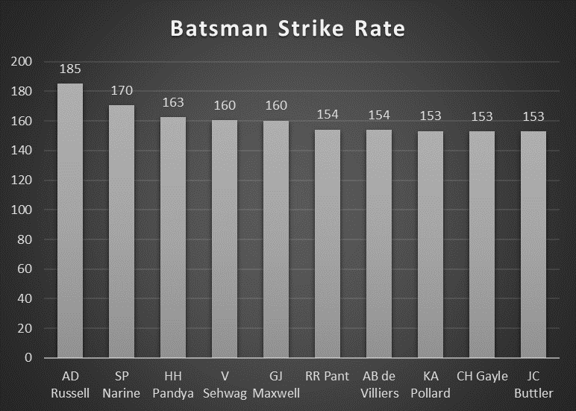
To get 2-3 players with high S.R who have faced at least 500 balls.And to do that you have to make a list of 10 players
Query to answer this question below given,
SELECT
Batsman,
COUNT(*) AS Balls_Faced,
SUM(Batsman_Runs) AS Total_Runs,
(SUM(Batsman_Runs) * 1.0 / COUNT(*)) * 100 AS Strike_Rate
FROM
deliveries
Where extra_runs = 0
GROUP BY
Batsman
HAVING
COUNT(*) > 500
ORDER BY Strike_Rate desc limit 10;

Slide 3
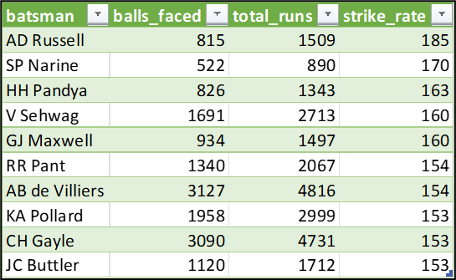

Slide 4
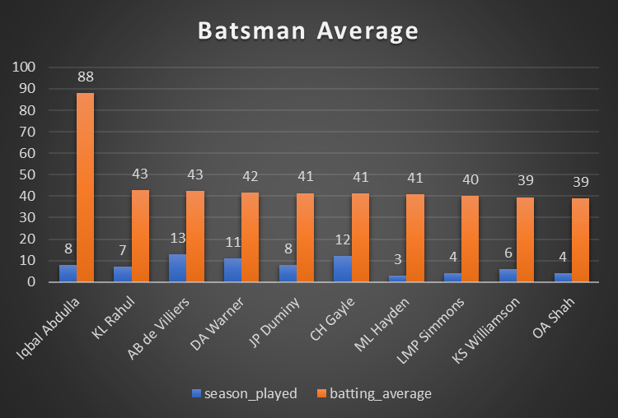
To get 2-3 players with good Average who have played more than 2 ipl seasons. And to do that you have to make a list of 10 players
Query to answer this question below given,
select a.batsman, count(distinct(extract(year from m.date))) as season_played,
(sum(a.batsman_runs)*1.0/count(case when a.is_wicket = 1 then a.is_wicket end)) as batting_average
from deliveries as a
left join matches as m
on a.id = m.id
group by a.batsman
having count(distinct(extract(year from m.date)))>2
order by batting_average desc
limit 10;

Slide 5
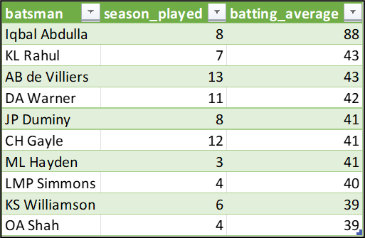

Slide 6
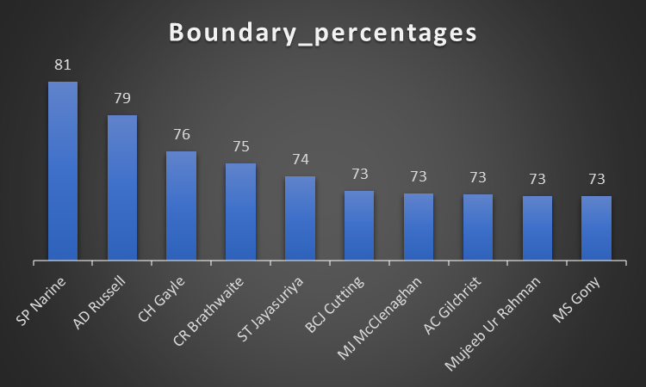
Now you need to get 2-3 Hard-hitting players who have scored most runs in boundaries and have played more the 2 ipl season. To do that you have to make a list of 10 players
WITH BoundaryStats AS (
SELECT
d.batsman AS player,
SUM(CASE WHEN d.batsman_runs = 4 THEN 4 WHEN d.batsman_runs = 6 THEN 6 ELSE 0 END) AS boundary_runs,
COUNT(DISTINCT EXTRACT(YEAR FROM m.date)) AS seasons_played,
SUM(d.batsman_runs) AS total_runs,
COUNT(d.ball) AS total_balls_faced
FROM deliveries d
JOIN matches m ON d.id = m.id
GROUP BY d.batsman
HAVING COUNT(DISTINCT EXTRACT(YEAR FROM m.date)) > 2 -- Played more than 2 IPL seasons
)
SELECT
player,
boundary_runs,
total_runs,
total_balls_faced,
(boundary_runs * 1.0 / total_runs) * 100 AS boundary_percentage
FROM BoundaryStats
ORDER BY boundary_percentage DESC
LIMIT 10;

Slide 7
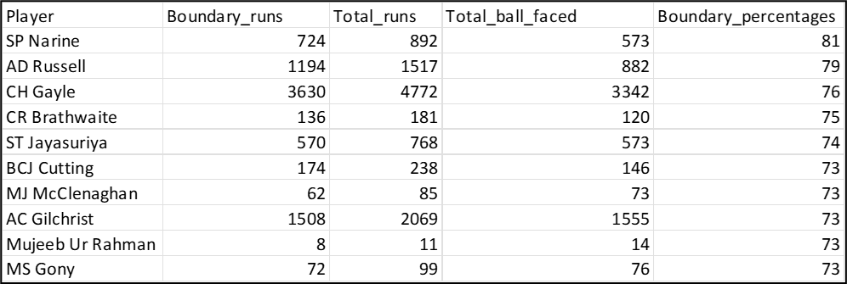

Slide 8
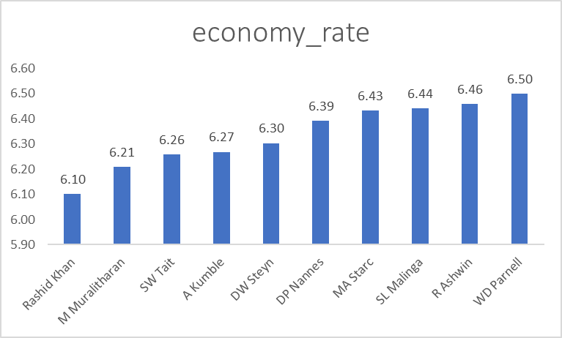
To get 2-3 bowlers with good economy who have bowled at least 500 balls in IPL so far.To do that you have to make a list of 10 players
Query to answer this question below given,
SELECT
bowler,
SUM(total_runs) AS total_runs_conceded,
SUM(total_balls) / 6.0 AS total_overs_bowled,
SUM(total_runs) / (SUM(total_balls) / 6.0) AS economy
FROM (
SELECT d.bowler, SUM(d.total_runs) AS total_runs, COUNT(*) AS total_balls
FROM deliveries d
INNER JOIN matches m ON d.match_id = m.match_id
GROUP BY d.bowler
HAVING COUNT(*) >= 500
) AS BowlingStats
GROUP BY bowler
ORDER BY economy ASC
LIMIT 10;

Slide 9
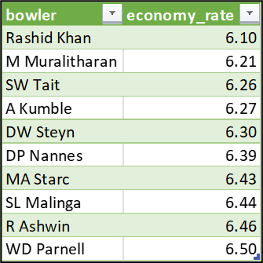

Slide 10
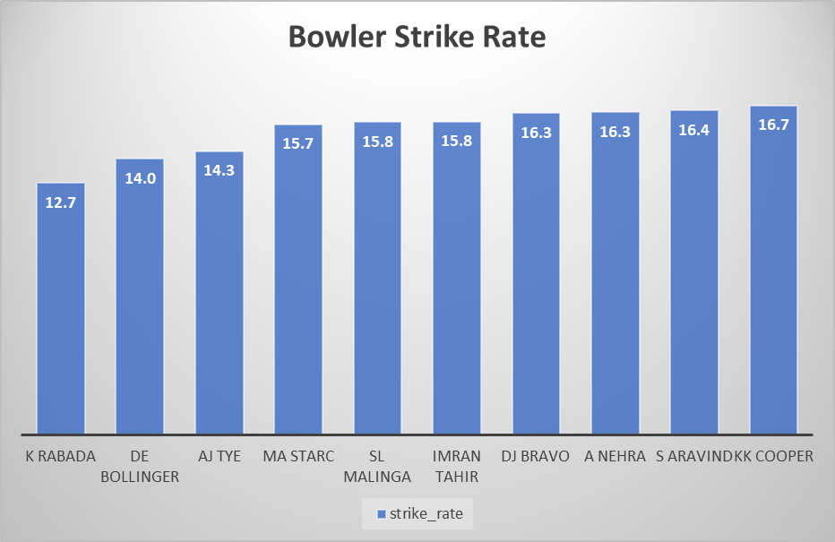
To get 2-3 bowlers with the best strike rate and who have bowled at least 500 balls in IPL so far.To do that you have to make a list of 10 players
Query to answer this question below given,
WITH BowlerStats AS (
SELECT
bowler,
COUNT(*) AS balls_bowled,
SUM(CASE WHEN is_wicket = 1 THEN 1 ELSE 0 END) AS wickets_taken
FROM
deliveries
GROUP BY
bowler
HAVING
COUNT(*) >= 500
)
SELECT
bowler,
balls_bowled / (wickets_taken * 1.0) AS strike_rate
FROM
BowlerStats
ORDER BY
strike_rate ASC
LIMIT 10;

Slide 11
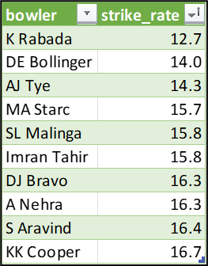

Slide 12
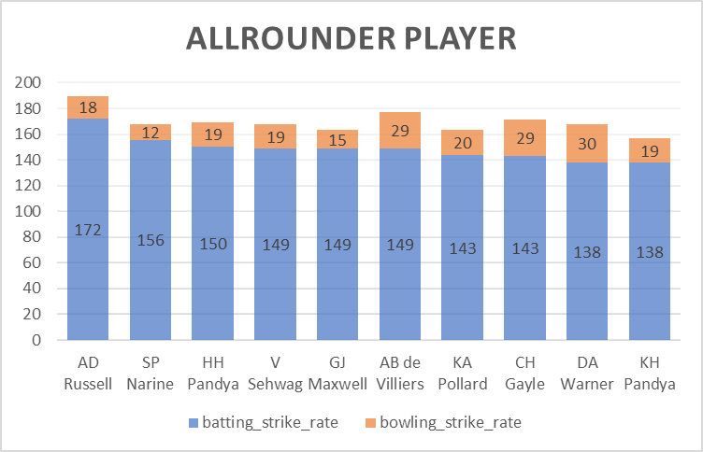
To get 2-3 All_rounders with the best batting as well as bowling strike rate and who have faced at least 500 balls in IPL so far and have bowled minimum 300 balls.To do that you have to make a list of 10 players
Query to answer this question below given,
WITH PlayerStats AS (
SELECT
batsman AS player,
COUNT(*) FILTER (WHERE batsman_runs IS NOT NULL) AS balls_faced,
SUM(batsman_runs) AS total_runs,
SUM(CASE WHEN is_wicket = 1 THEN 1 ELSE 0 END) AS wickets_taken,
COUNT(*) FILTER (WHERE extra_runs IS NOT NULL OR batsman_runs IS NOT NULL) AS balls_bowled
FROM deliveries
GROUP BY batsman
HAVING COUNT(*) FILTER (WHERE batsman_runs IS NOT NULL) >= 500
AND COUNT(*) FILTER (WHERE extra_runs IS NOT NULL OR batsman_runs IS NOT NULL) >= 300
AND SUM(CASE WHEN is_wicket = 1 THEN 1 ELSE 0 END) > 0 -- Ensure they have taken at least one wicket
)
SELECT player,
(total_runs * 1.0 / balls_faced) * 100 AS batting_strike_rate,
(balls_bowled * 1.0 / wickets_taken) AS bowling_strike_rate
FROM PlayerStats
Where player not in ('JC Buttler', 'RR Pant')
ORDER BY batting_strike_rate DESC, bowling_strike_rate ASC
LIMIT 10;

Slide 13
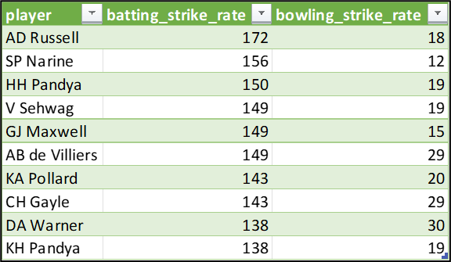

Slide 14
Define a criteria best suited for a wicketkeeper required in a t20 team so that your team will be complete and have everything required for winning this year’s IPL.
Batting Criteria (40 points total)
Strike Rate: 15 points
Average Runs per Match: 10 points
Boundary Hitting Ability: 10 points
Finishing Ability: 5 points
Wicketkeeping Criteria (30 points total)
Dismissals per Match: 15 points
Stumping Speed and Accuracy: 10 points
Byes Conceded: 5 points
Overall Impact Criteria (30 points total)
Fielding Skills: 10 points
Versatility: 10 points
Fitness and Agility: 5 points
Experience and Leadership: 5 points

Slide 15
Thank You for Your Support

